Slide 1

Topic: Statistics Investigation EQ: How do I use the Mathematical Thinking Process to solve problems?
Year 7 Mathematics
Mrs Parlevliet

Slide 2
Contents
Glossary or Formula Page
Page
Date
Essential Question
24
7
30
Word or Formula
Definition or Example

Slide 3
Tasks
24
7
30
Topic
Essential Question
Questions
Notes
Summary
1
2

Slide 4
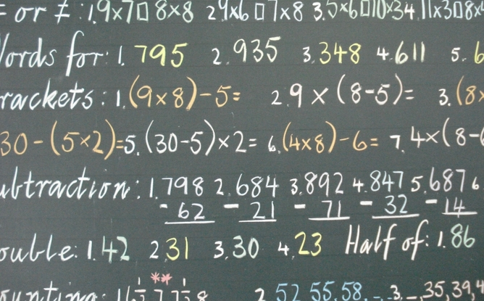
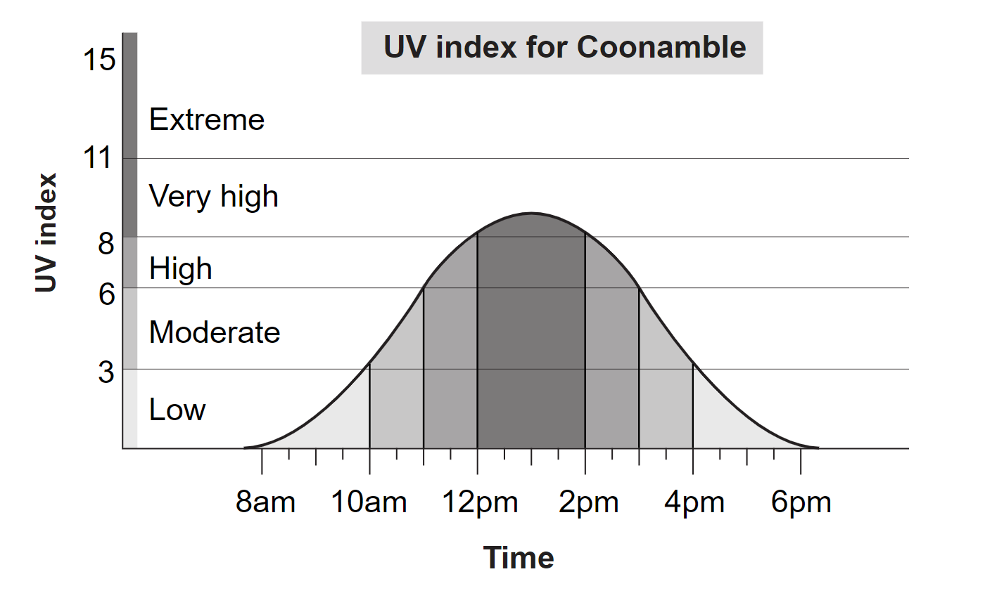

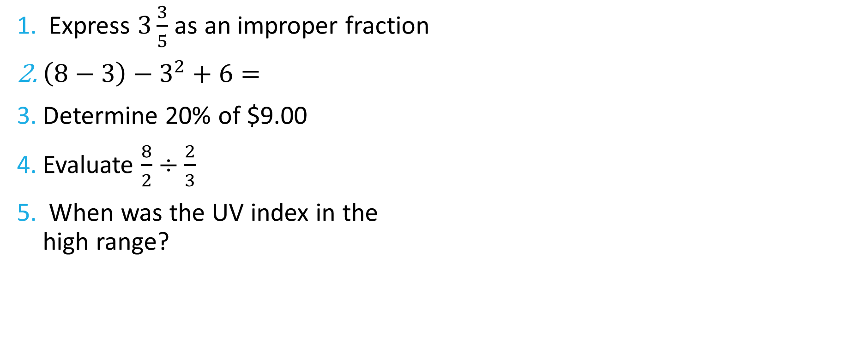
Five Questions (LHS)
Topic: Statistics EQ: What is the Mathematical Thinking Process?
Date: XX/XX/2021
Express $3\frac{3}{5}$ as an improper fraction
$\left(8−3\right)−3^{2}+6=$
Determine 20% of $9.00
Evaluate $\frac{8}{2}÷\frac{2}{3}$
When was the UV index in the high range?
This Photo by Unknown Author is licensed uder CC BY-ND
Notes:
-10
159
$\frac{1}{10},\frac{1}{5},\frac{1}{3},\frac{1}{2}$
$\frac{16}{6}=\frac{8}{3}$
a) 24 cars per month b) 6 cars per week

Slide 5

24
7
30
Topic: Statistics
Date: XX/XX/2021
EQ: How do I use the Mathematical Thinking Process to solve problems?
What is the Mathematical Thinking Process?
The Mathematical Thinking Process are the 6 steps that we use to solve problems in Mathematics.
The 6 steps are:
Interpret the task and gather information
Identify the mathematics which could help to complete the task
Analyse information and data from a variety of sources
Apply existing mathematical knowledge and strategies to obtain a solution
Check that your solution makes sense and provides answers to the problem.
Communicate your findings clearly.

Slide 6

The Problem
How many times could you say the alphabet in 24 hours?

Slide 7

Step 1: Interpret the task and gather information
State the question and clarify the interpretation.
© innovativeteachingideas.com

Slide 8

Step 1: Interpret the task and gather information State the questions and clarify the interpretation.
We are being asked to find how many times a person could say the alphabet in 24 hours. We are interpreting this to mean; how many times could a person say the alphabet in 24 hours without stopping for any reason (for example to take a nap or go to the bathroom). We are only counting the time it takes for the person to recite the alphabet and not any other parts of the song (“now I know my ABC’s, next time won’t you sing with me”).
© innovativeteachingideas.com
This Photo by Unknown Author is licensed under CC BY-SA-NC

Slide 9

Step 2: Identify the mathematics that could help answer the question Make an educated guess using a chain of logic to come up with an estimate. List some questions you would need to answer to figure out the problem
Some questions we may need to answer:
How many seconds are in 24 hours?
How long does it take to recite the alphabet?
Estimate using logic:
There are 26 letters in the alphabet. Assuming it takes me a second to say each letter, it would take me 26 seconds to say the alphabet.
At this rate I could roughly say the alphabet about 138 times in an hour. 138 x 24 = 3,312.
© innovativeteachingideas.com

Slide 10
Step 3: Analyse information and data from a range of sources Perform experiments, conduct surveys and make measurements.
There are 26 letters in the alphabet
It takes me 13.6 seconds to recite the alphabet
What can you do to find out how long it takes you to recite the alphabet?
© innovativeteachingideas.com

Slide 11
Step 4: Apply existing mathematic knowledge and strategies to obtain a solution Perform experiments, conduct surveys and make measurements. If appropriate, create and use formulas.
Use your measurements and any recorded values to calculate your answer.
There are 60 seconds in 1 minute, 60 minutes in 1 hour
There are 24 hours in one day
There are 3,600 seconds in 1 hour, 86, 400 seconds in 1 day
86,400
= 6,352.94
13.6
© innovativeteachingideas.com

Slide 12
Step 5: Check that your solution makes sense Are your answers realistic? Can someone carry out your answer in real life?
It takes 13.6 seconds to say the alphabet. Given that there are 86,400 seconds in 24 hour, one could recite the alphabet 6,352 times in that time frame. This is without taking a break or making no mistakes which could be difficult to do.
86,400
= 6,352.94
13.6
© innovativeteachingideas.com

Slide 13
Step 6: Conclusion State your final answer. Discuss possible sources of error, interesting facts learned and possible extensions.
Based on this analysis, we conclude that we can say the alphabet 6,352 times in 24 hours.
It takes 13.6 seconds to say the alphabet. Given that there are 86,400 seconds in 24 hour, one could recite the alphabet 6,352 times in that time frame.
One possible source of error is that we did not account for any breaks or mistakes. This might be unrealistic if attempted in real life.
One interesting fact I learned is that there are about 100 languages that use an alphabet similar to English. While some languages have a few more and others a few less, they all share the core 23 letters originally found in the Roman alphabet. It would be interesting to compare the number of times one could recite the alphabet in different languages given the same time frame.
© innovativeteachingideas.com

Slide 14

Summary
Write your summary.
Answer the EQ: How do I use the Mathematical Thinking Process to solve problems?

Slide 15
Step 1: Interpret the task and gather information State the questions and clarify the interpretation.
This Photo by Unknown Author is licensed under CC BY-SA-NC
© innovativeteachingideas.com
Notes:
Slides 15 – 20 can be printed as a work package to be completed in class by students as they are guided through the Mathematical Thinking Process to solve the problem.

Slide 16
Step 2: Identify the mathematics that could help ask answer the question Make an educated guess using a chain of logic to come up with an estimate. List some questions you would need to answer to figure out the problem
© innovativeteachingideas.com

Slide 17
Step 3: Analyse information and data from a range of sources Perform experiments, conduct surveys and make measurements.
© innovativeteachingideas.com

Slide 18
Step 4: Apply existing mathematic knowledge and strategies to obtain a solution Perform experiments, conduct surveys and make measurements. If appropriate, create and use formulas.
© innovativeteachingideas.com

Slide 19
Step 5: Check that your solution makes sense Are your answers realistic? Can someone carry out your answer in real life?
© innovativeteachingideas.com

Slide 20
Step 6: Conclusion State your final answer. Discuss possible sources of error, interesting facts learned and possible extensions.
© innovativeteachingideas.com

